Slide 1
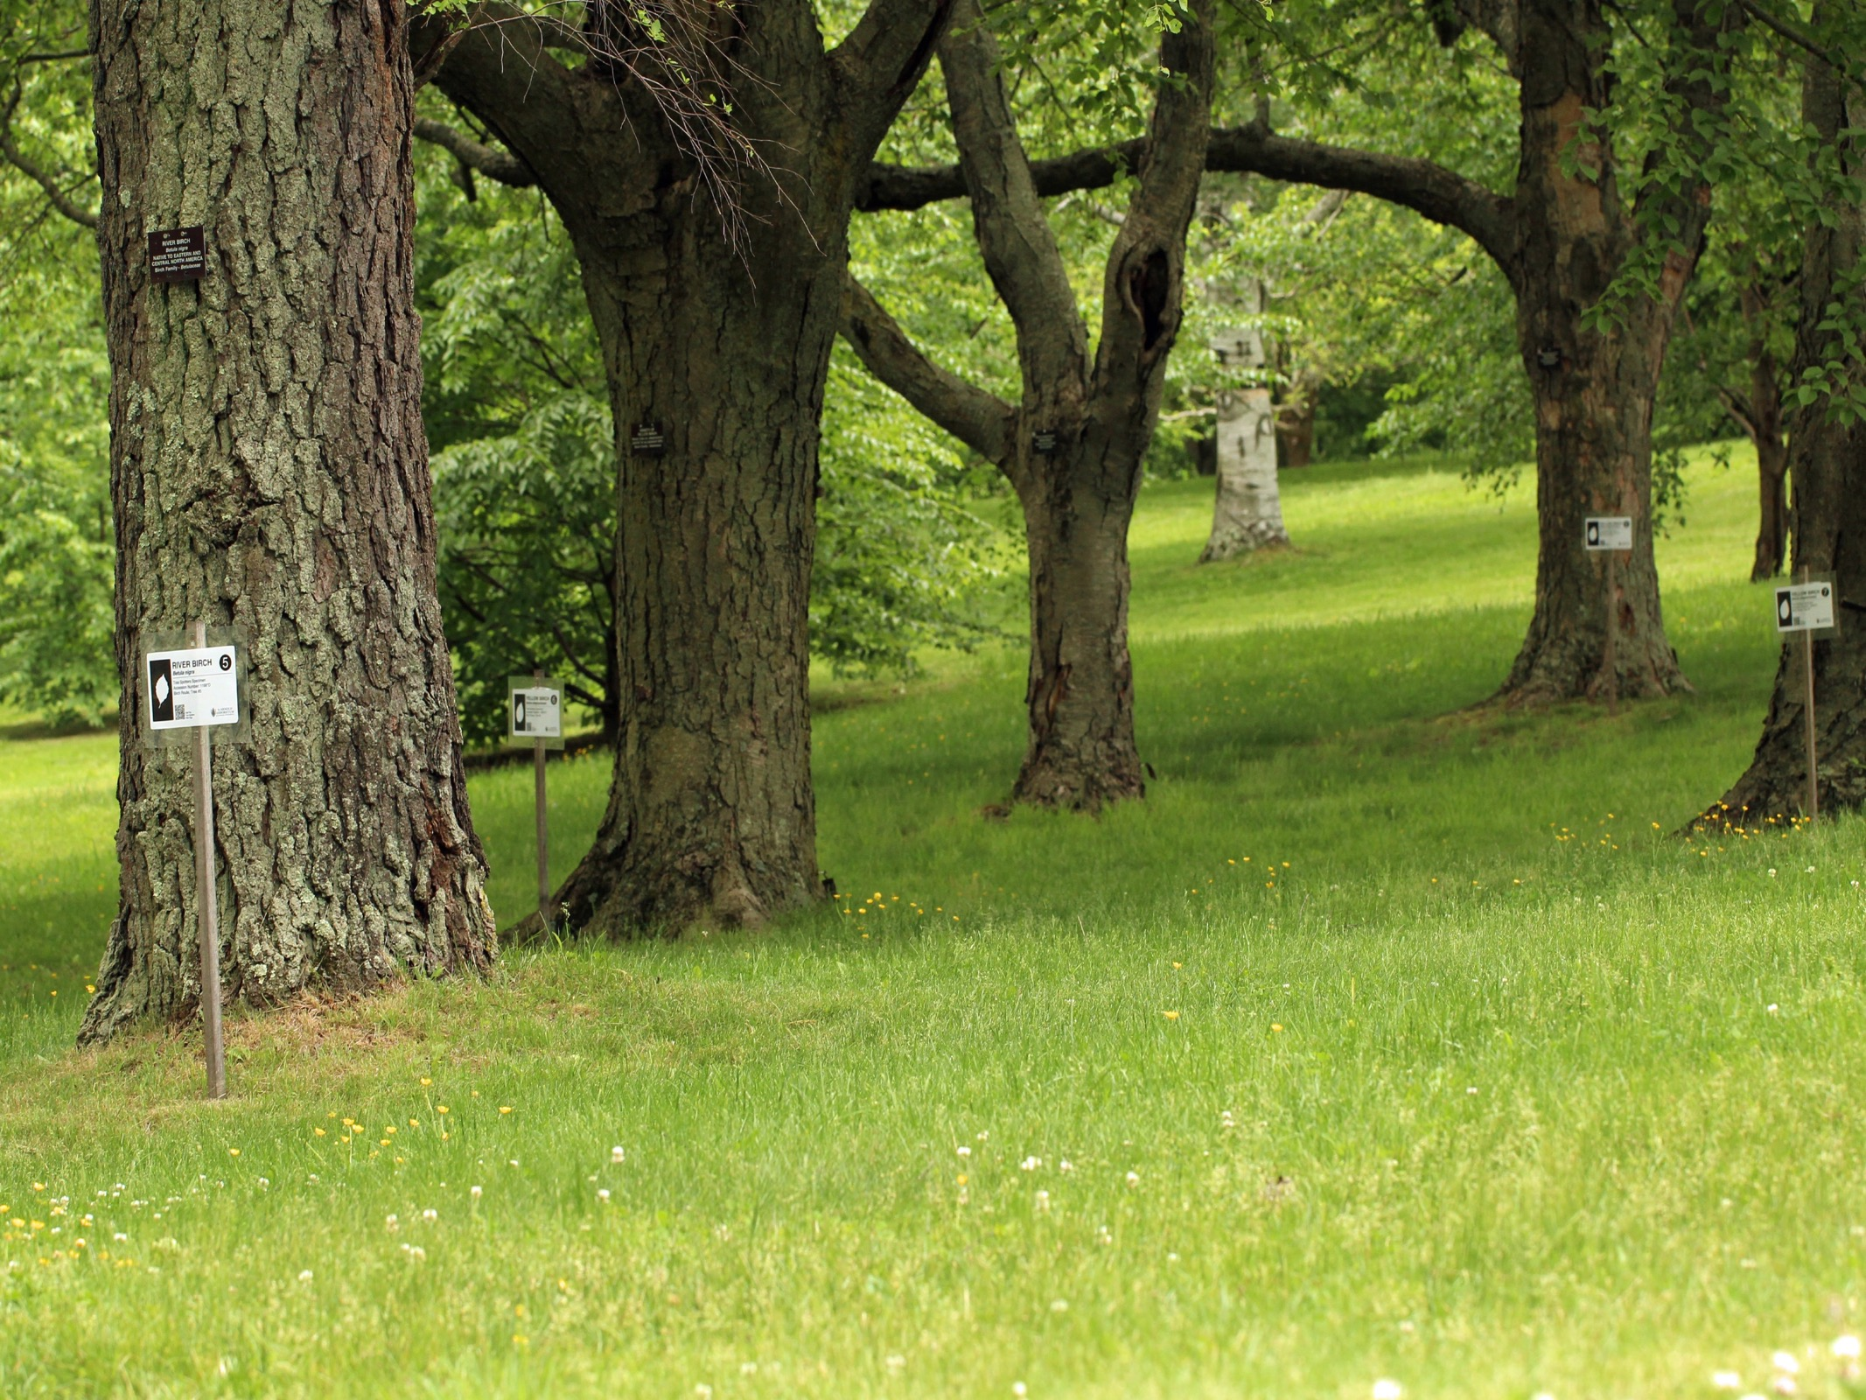




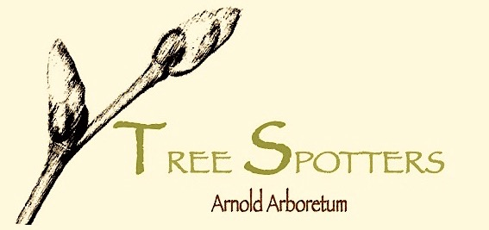
Temporal Ecology Lab, Harvard University
Suzanne Mrozak, Volunteer Coordinator
Danny Schissler, Intern
Cat Chamberlain, Graduate Student

Slide 2
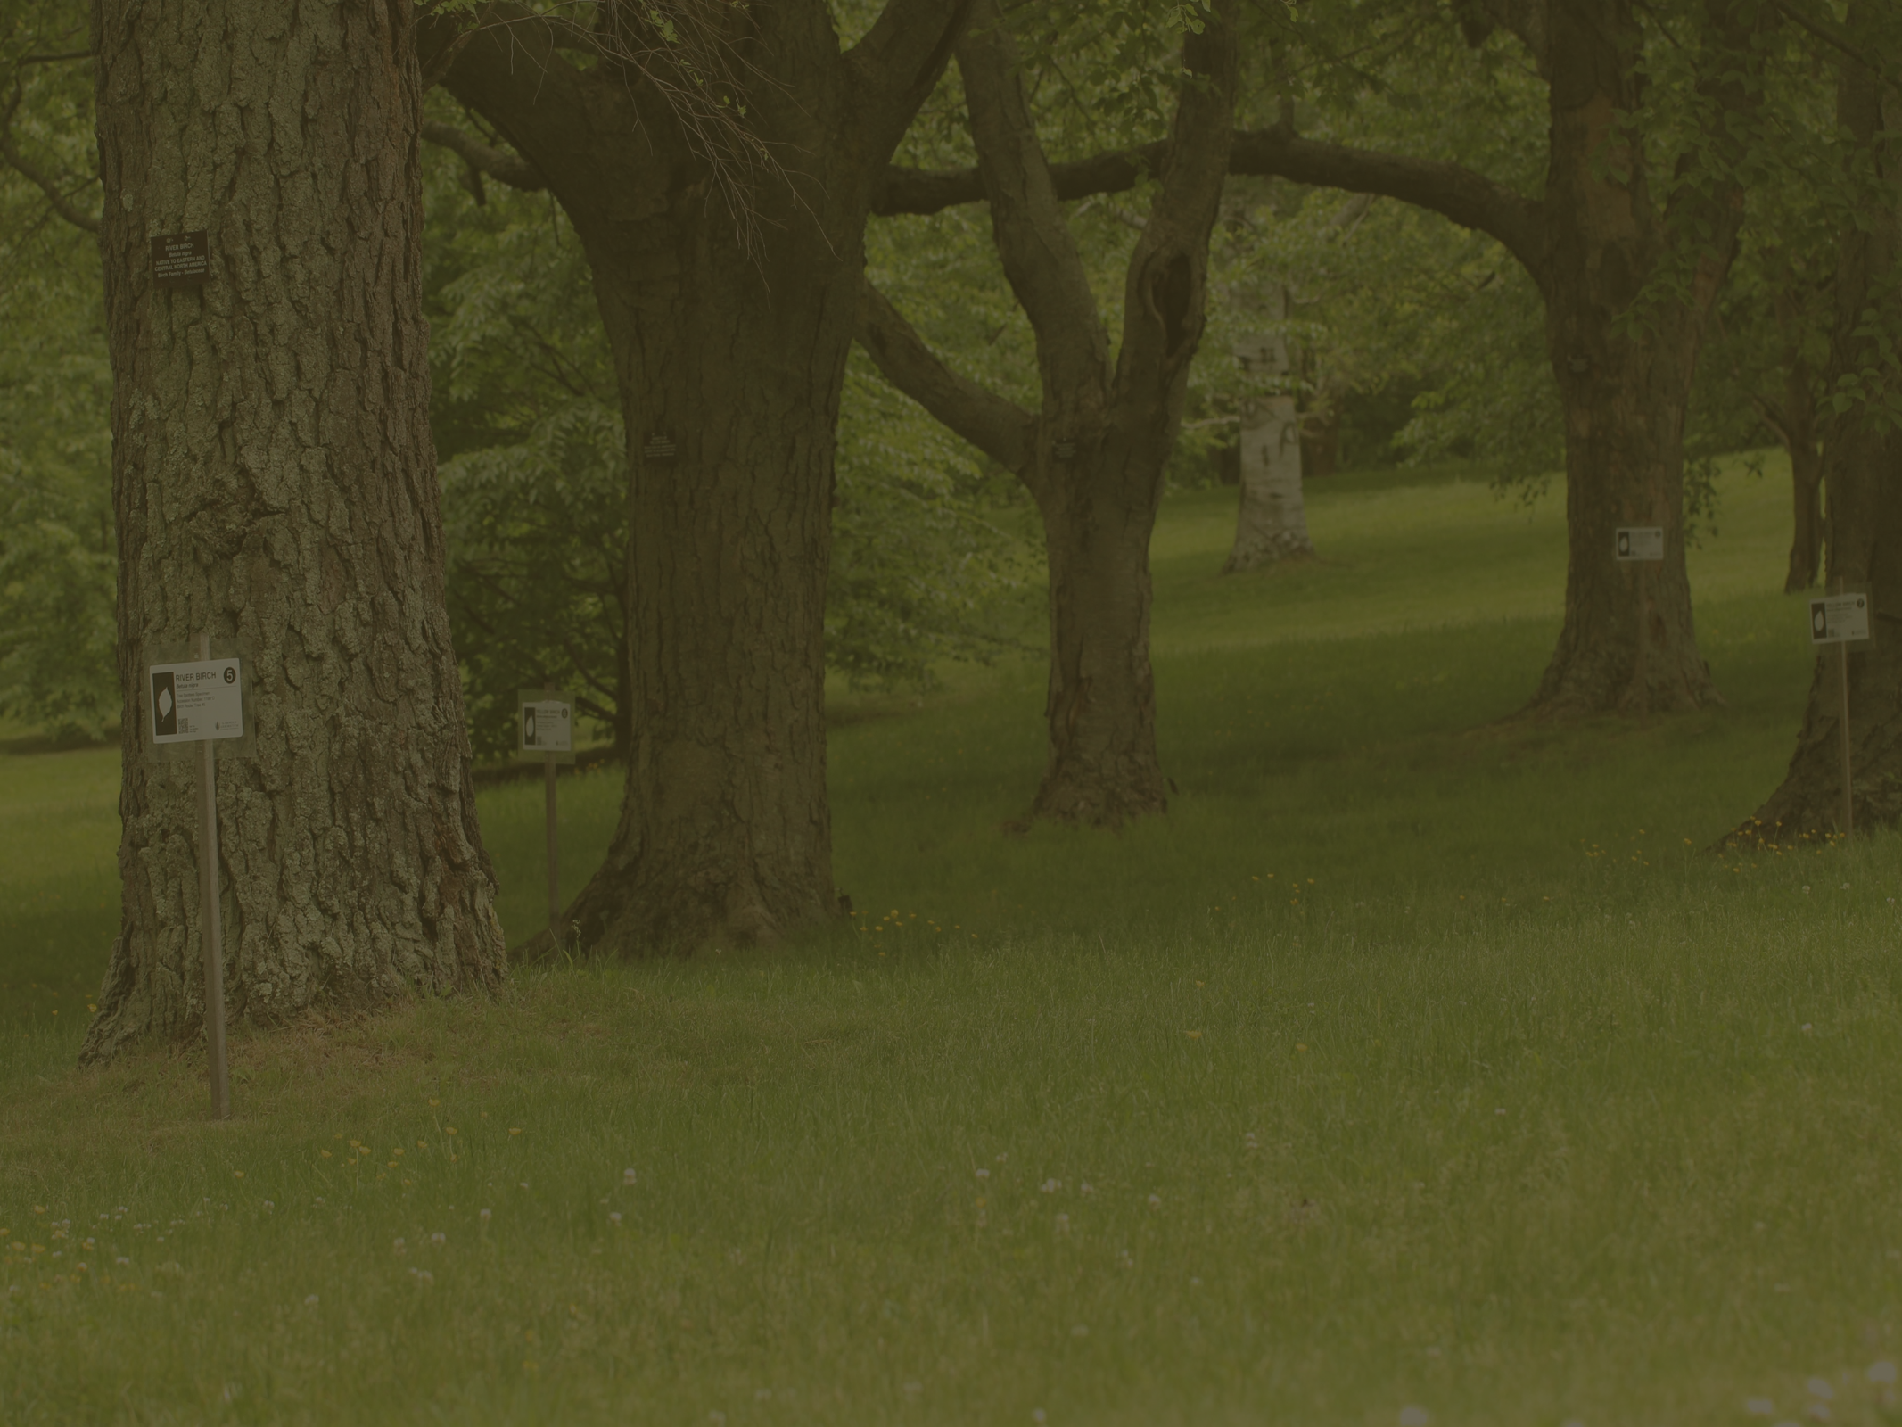
OVERVIEW
The Tree Spotter Story
Our Volunteers
The Numbers
Graphs and Figures
Photos
Tree Spotter Song
THANK YOU!

Slide 3
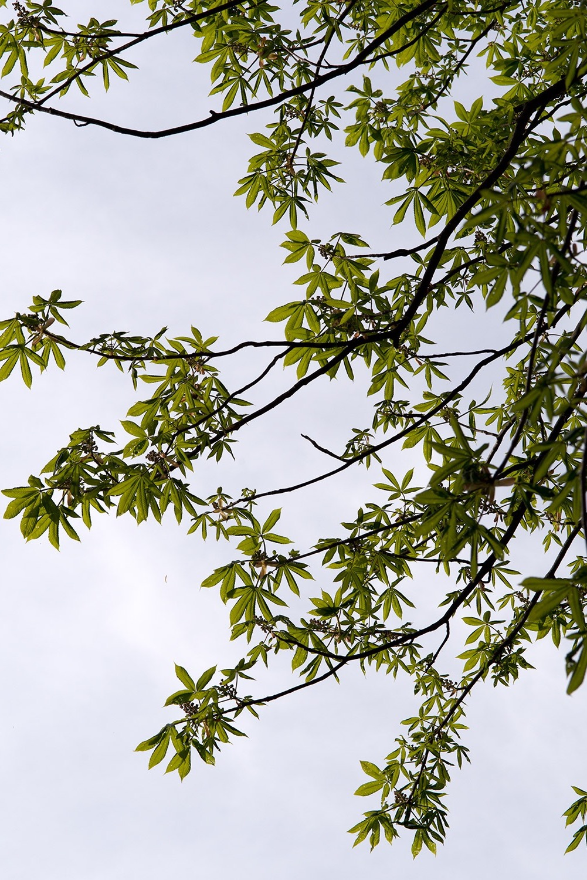
Our Story
The Tree Spotters Citizen Science Program started just over a year ago through Lizzie Wolkovich’s Temporal Ecology Lab.
The first meeting for the project was held March 25, 2015.
The aim of the project is to work with local citizen scientists and collect phenological observations for 55 individual trees throughout the arboretum.
Volunteers record observations for 11 different phenophases in Nature’s Notebook, an online portal system through the USA National Phenology Network (NPN).

Slide 4
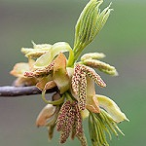
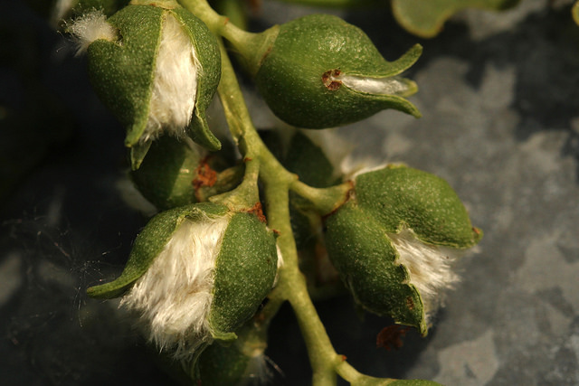
PHENOPHASES OBSERVED
Leaves:
Breaking Leaf Buds
Leaves
Increasing Leaf Size
Colored Leaves
Falling Leaves
Flowers:
Flowers or Flower Buds
Open Flowers
Fruits:
Fruits
Ripe Fruits

Slide 5
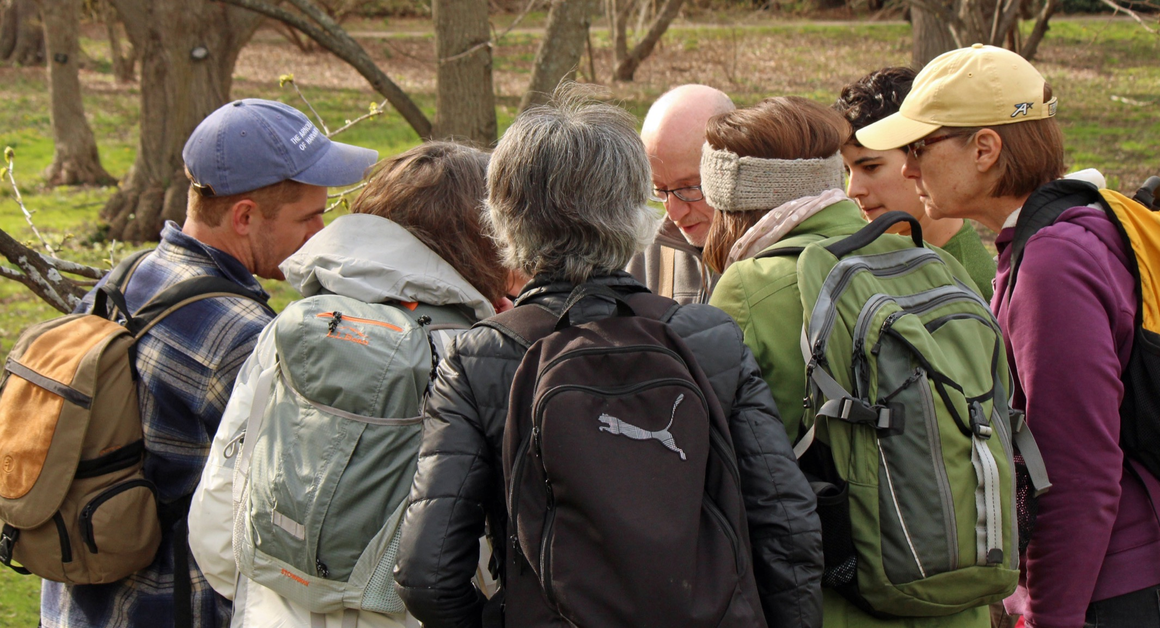
Our Volunteers

Slide 6
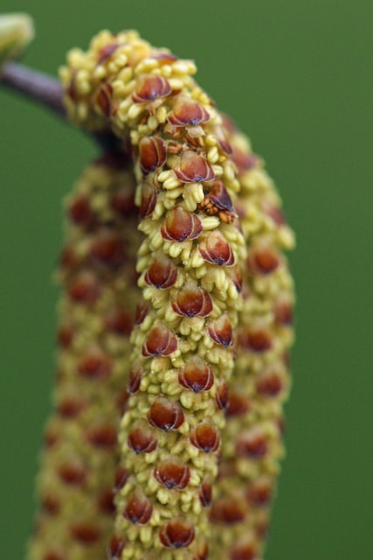
The numbers
The first training session was held May 17, 2015.
So far, there have been 179 individuals in the local community trained to Tree Spot.
Of those 179 trained, 57 observers are still active today, which gives us a retention rate of 31.8%!
The NPN recommends striving for a retention rate of 20%.
125 Tree Spotter volunteers have registered accounts on the Nature’s Notebook website, giving us a success rate of 45.6% of users who have completely signed up and been trained.
We are SO pleased with our volunteers!! Thank you!

Slide 7
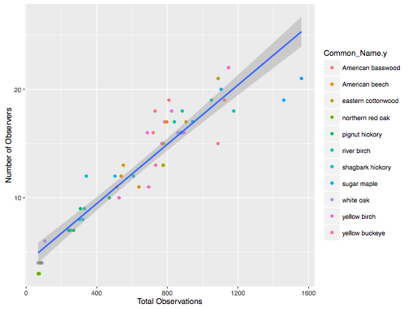
Total observations and observers per tree this year
Common Name
The oaks have the fewest number of observations and observers

Slide 8
Observations
Breakdown of Observations in 2016
Acquisition Number | Number of Observations | Number of Observers | Route and Tree Number
14585*B American beech | 538 | 12 | Beech - 1
14585*D American beech | 797 | 17 | Beech - 2
14585*C American beech | 551 | 13 | Beech - 3
14585*G American beech | 514 | 11 | Beech - 4
14585*J American beech | 639 | 11 | Beech - 5
1199*J River birch | 608 | 12 | Birch - 1
1251-79*B River birch | 1176 | 18 | Birch - 2
1251-79*A River birch | 1050 | 19 | Birch - 3
1251-79*E River birch | 885 | 18 | Birch - 4
1199*D River birch | 840 | 17 | Birch - 5
12843*A Yellow birch | 824 | 18 | Birch - 6
12843*D Yellow birch | 687 | 16 | Birch - 7
12843*H Yellow birch | 769 | 15 | Birch - 8
12843*E Yellow birch | 894 | 16 | Birch - 9
629-83*D Yellow birch | 883 | 16 | Birch - 10
12907*I Shagbark hickory | 320 | 8 | Hickory -1
12907*G Shagbark hickory | 504 | 12 | Hickory - 2
12907*B Shagbark hickory | 302 | 8 | Hickory - 3
12907*D Shagbark hickory | 330 | 9 | Hickory - 4
12907*N Shagbark hickory | 341 | 12 | Hickory - 5
20095*A Pignut hickory | 308 | 9 | Hickory - 6
6990*A Pignut hickory | 269 | 7 | Hickory - 7
20098*A Pignut hickory | 240 | 7 | Hickory - 8
2019*S Pignut hickory | 251 | 7 | Hickory - 9
2019*R Pignut hickory | 471 | 10 | Hickory- 10

Slide 9
Breakdown of Observations (cont.)
Acquisition Number | Number of Observations | Number of Observers | Route and Tree Number
17527*D American basswood | 809 | 19 | Linden/North Woods - 1
19804*A American basswood | 731 | 18 | Linden/North Woods - 2
7141*A American basswood | 720 | 16 | Linden/North Woods - 3
925-79*B Yellow buckeye | 1147 | 22 | Linden/North Woods - 4
12651*H Yellow buckeye | 734 | 13 | Linden/North Woods - 5
12651*D Yellow buckeye | 694 | 11 | Linden/North Woods - 6
12651*C Yellow buckeye | 527 | 10 | Linden/North Woods - 7
187-2006*B Sugar maple | 1460 | 19 | Maple - 1
22834*B Sugar maple | 1560 | 21 | Maple - 2
20645*A Sugar maple | 944 | 17 | Maple - 3
12565*C Sugar maple | 1105 | 20 | Maple - 4
8197*A Northern red oak | 80 | 4 | Oak - 1
5859*A Northern red oak | 71 | 3 | Oak -2
5859*B Northern red oak | 75 | 3 | Oak - 3
16882*B Northern red oak | 69 | 3 | Oak - 4
22886*D White oak | 68 | 4 | Oak - 5
227-2011*A White oak | 89 | 4 | Oak - 6
358-82*A White oak | 80 | 4 | Oak - 7
21815*E White oak | 106 | 6 | Oak - 8
11253*A Northern red oak | 89 | 4 | Oak - 9
1323-82*A American basswood | 1124 | 19 | Peter's Hill - 1
16611*F Eastern cottonwood | 776 | 13 | Peter's Hill - 2
16611*J Eastern cottonwood | 779 | 15 | Peter's Hill - 3
16611*K Eastern cottonwood | 778 | 13 | Peter's Hill - 4
16611*O Eastern cottonwood | 906 | 17 | Peter's Hill - 5
22099*A Eastern cottonwood | 1088 | 21 | Peter's Hill - 6
689-2010*A Sugar maple | 877 | 16 | Peter's Hill - 7
611-2010*A White oak | 860 | 16 | Peter's Hill - 8
12651*I Yellow buckeye | 785 | 17 | Peter's Hill - 9
17538*A American basswood | 1087 | 15 | Peter's Hill - 10

Slide 10
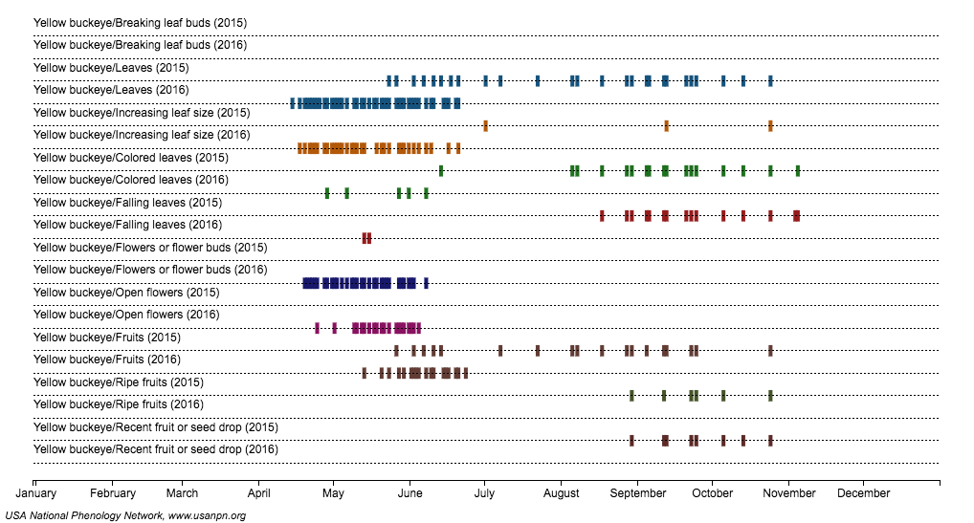
Comparing Observations 2015 to 2016:
Aesculus flava (Yellow Buckeye)

Slide 11
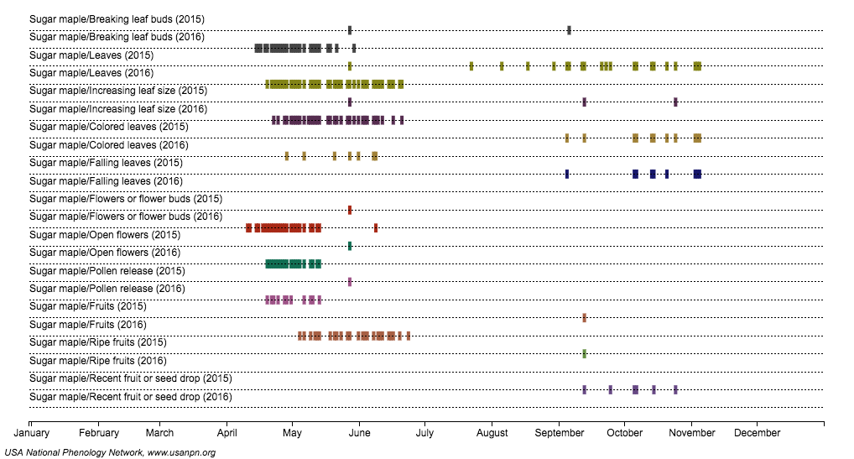
Comparing Observations 2015 to 2016:
Acer saccharum (Sugar Maple)

Slide 12
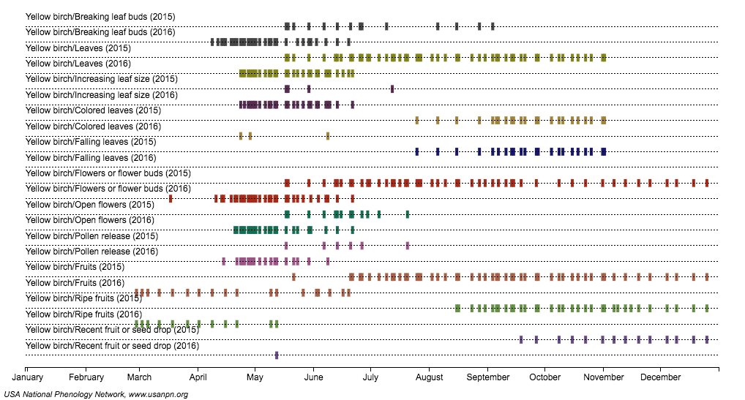
Comparing Observations 2015 to 2016:
Betula alleghaniensis (Yellow Birch)

Slide 13
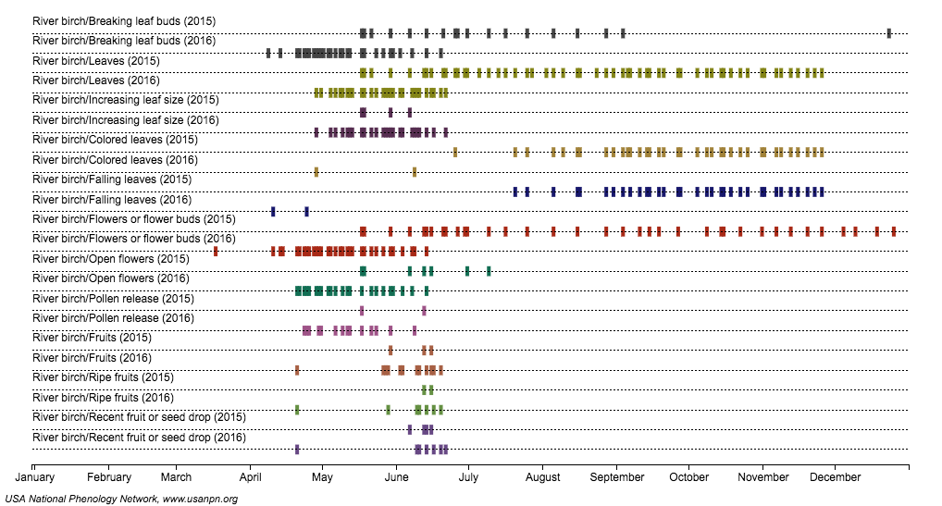
Comparing Observations 2015 to 2016:
Betula nigra (River Birch)

Slide 14
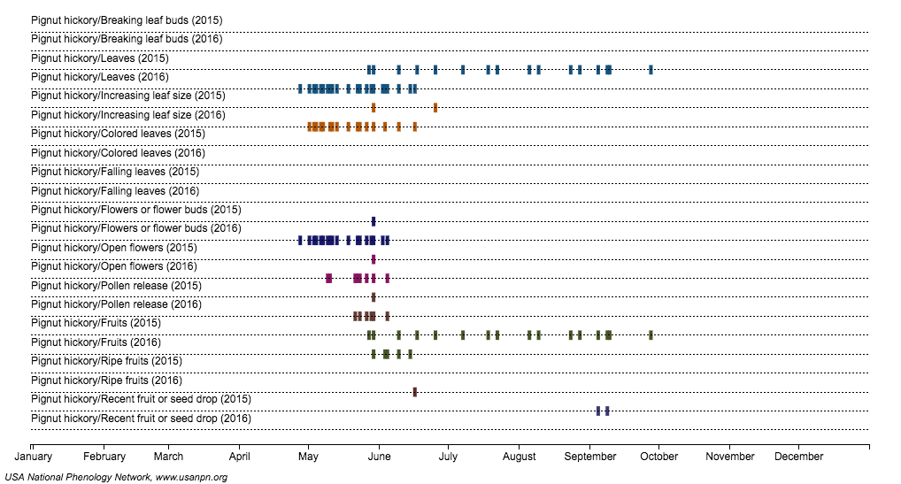
Comparing Observations 2015 to 2016:
Cayra glabra (Pignut Hickory)

Slide 15
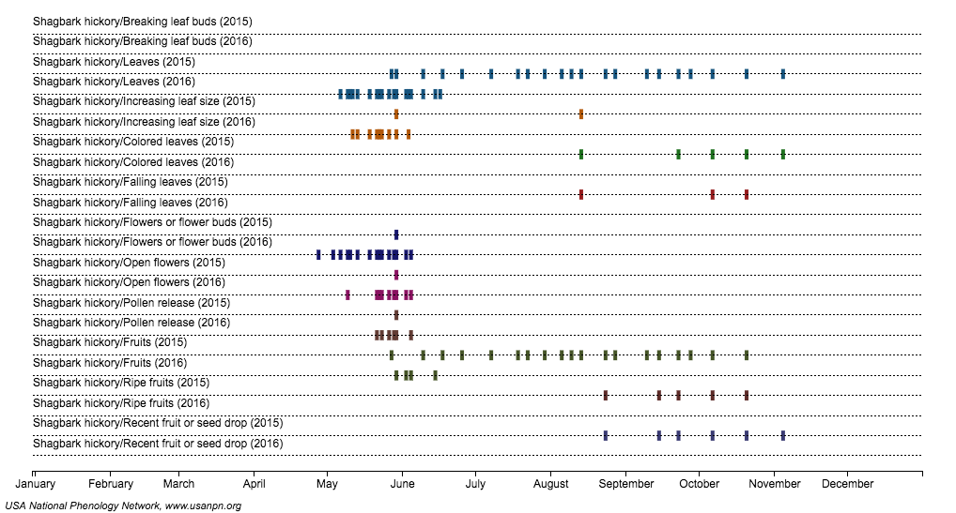
Comparing Observations 2015 to 2016:
Cayra ovata (Shagbark Hickory)

Slide 16
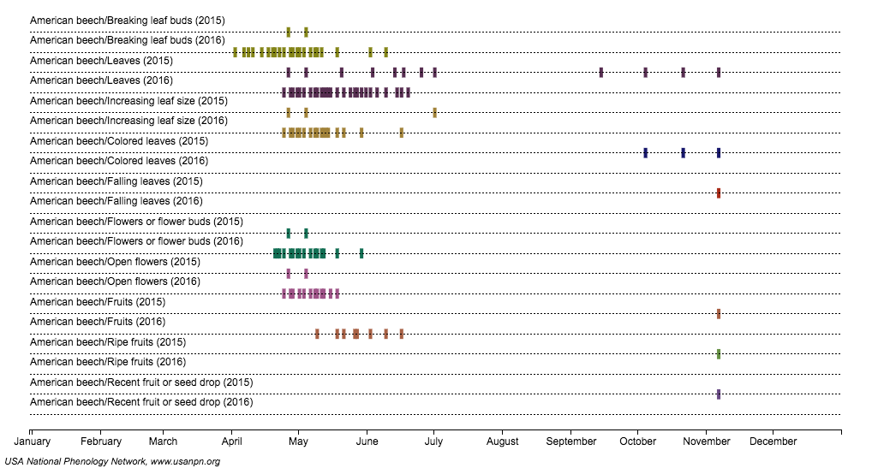
Comparing Observations 2015 to 2016:
Fagus grandifolia (American Beech)

Slide 17
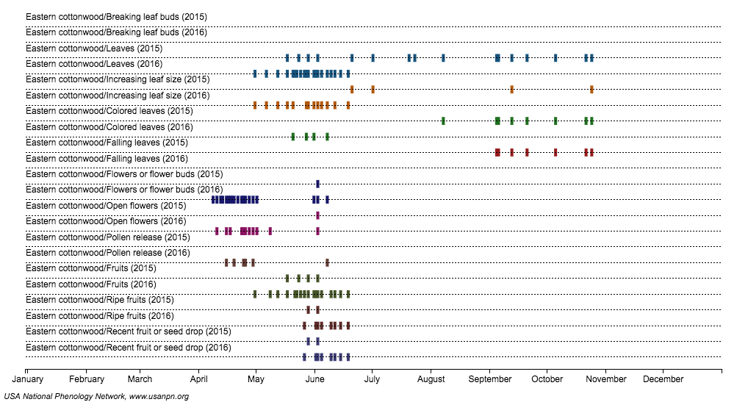
Comparing Observations 2015 to 2016:
Populus deltoides (Eastern Cottonwood)

Slide 18
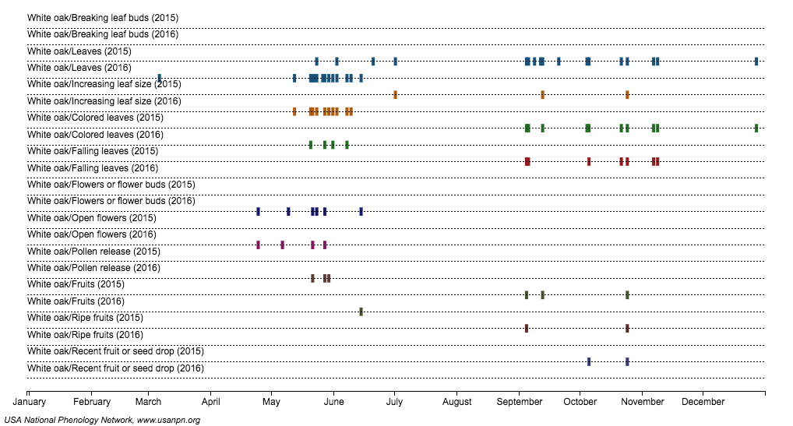
Comparing Observations 2015 to 2016:
Quercus alba (White Oak)

Slide 19
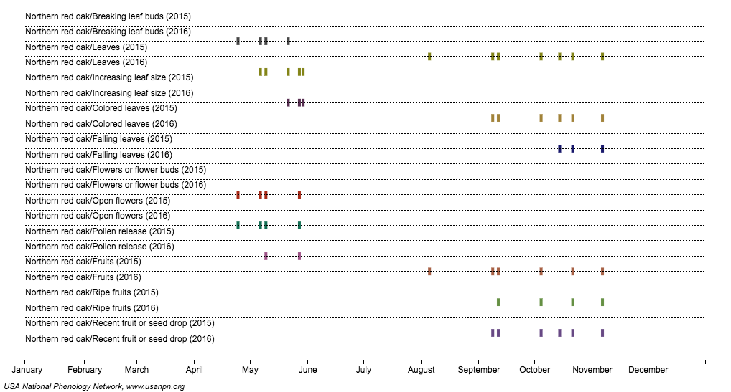
Comparing Observations 2015 to 2016:
Quercus rubra (Red Oak)

Slide 20
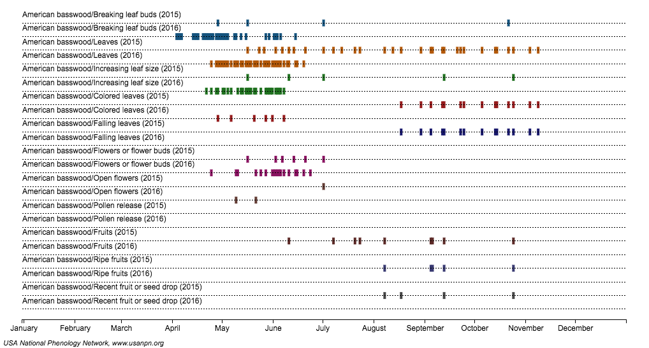
Comparing Observations 2015 to 2016:
Tilia americana (American Basswood)

Slide 21
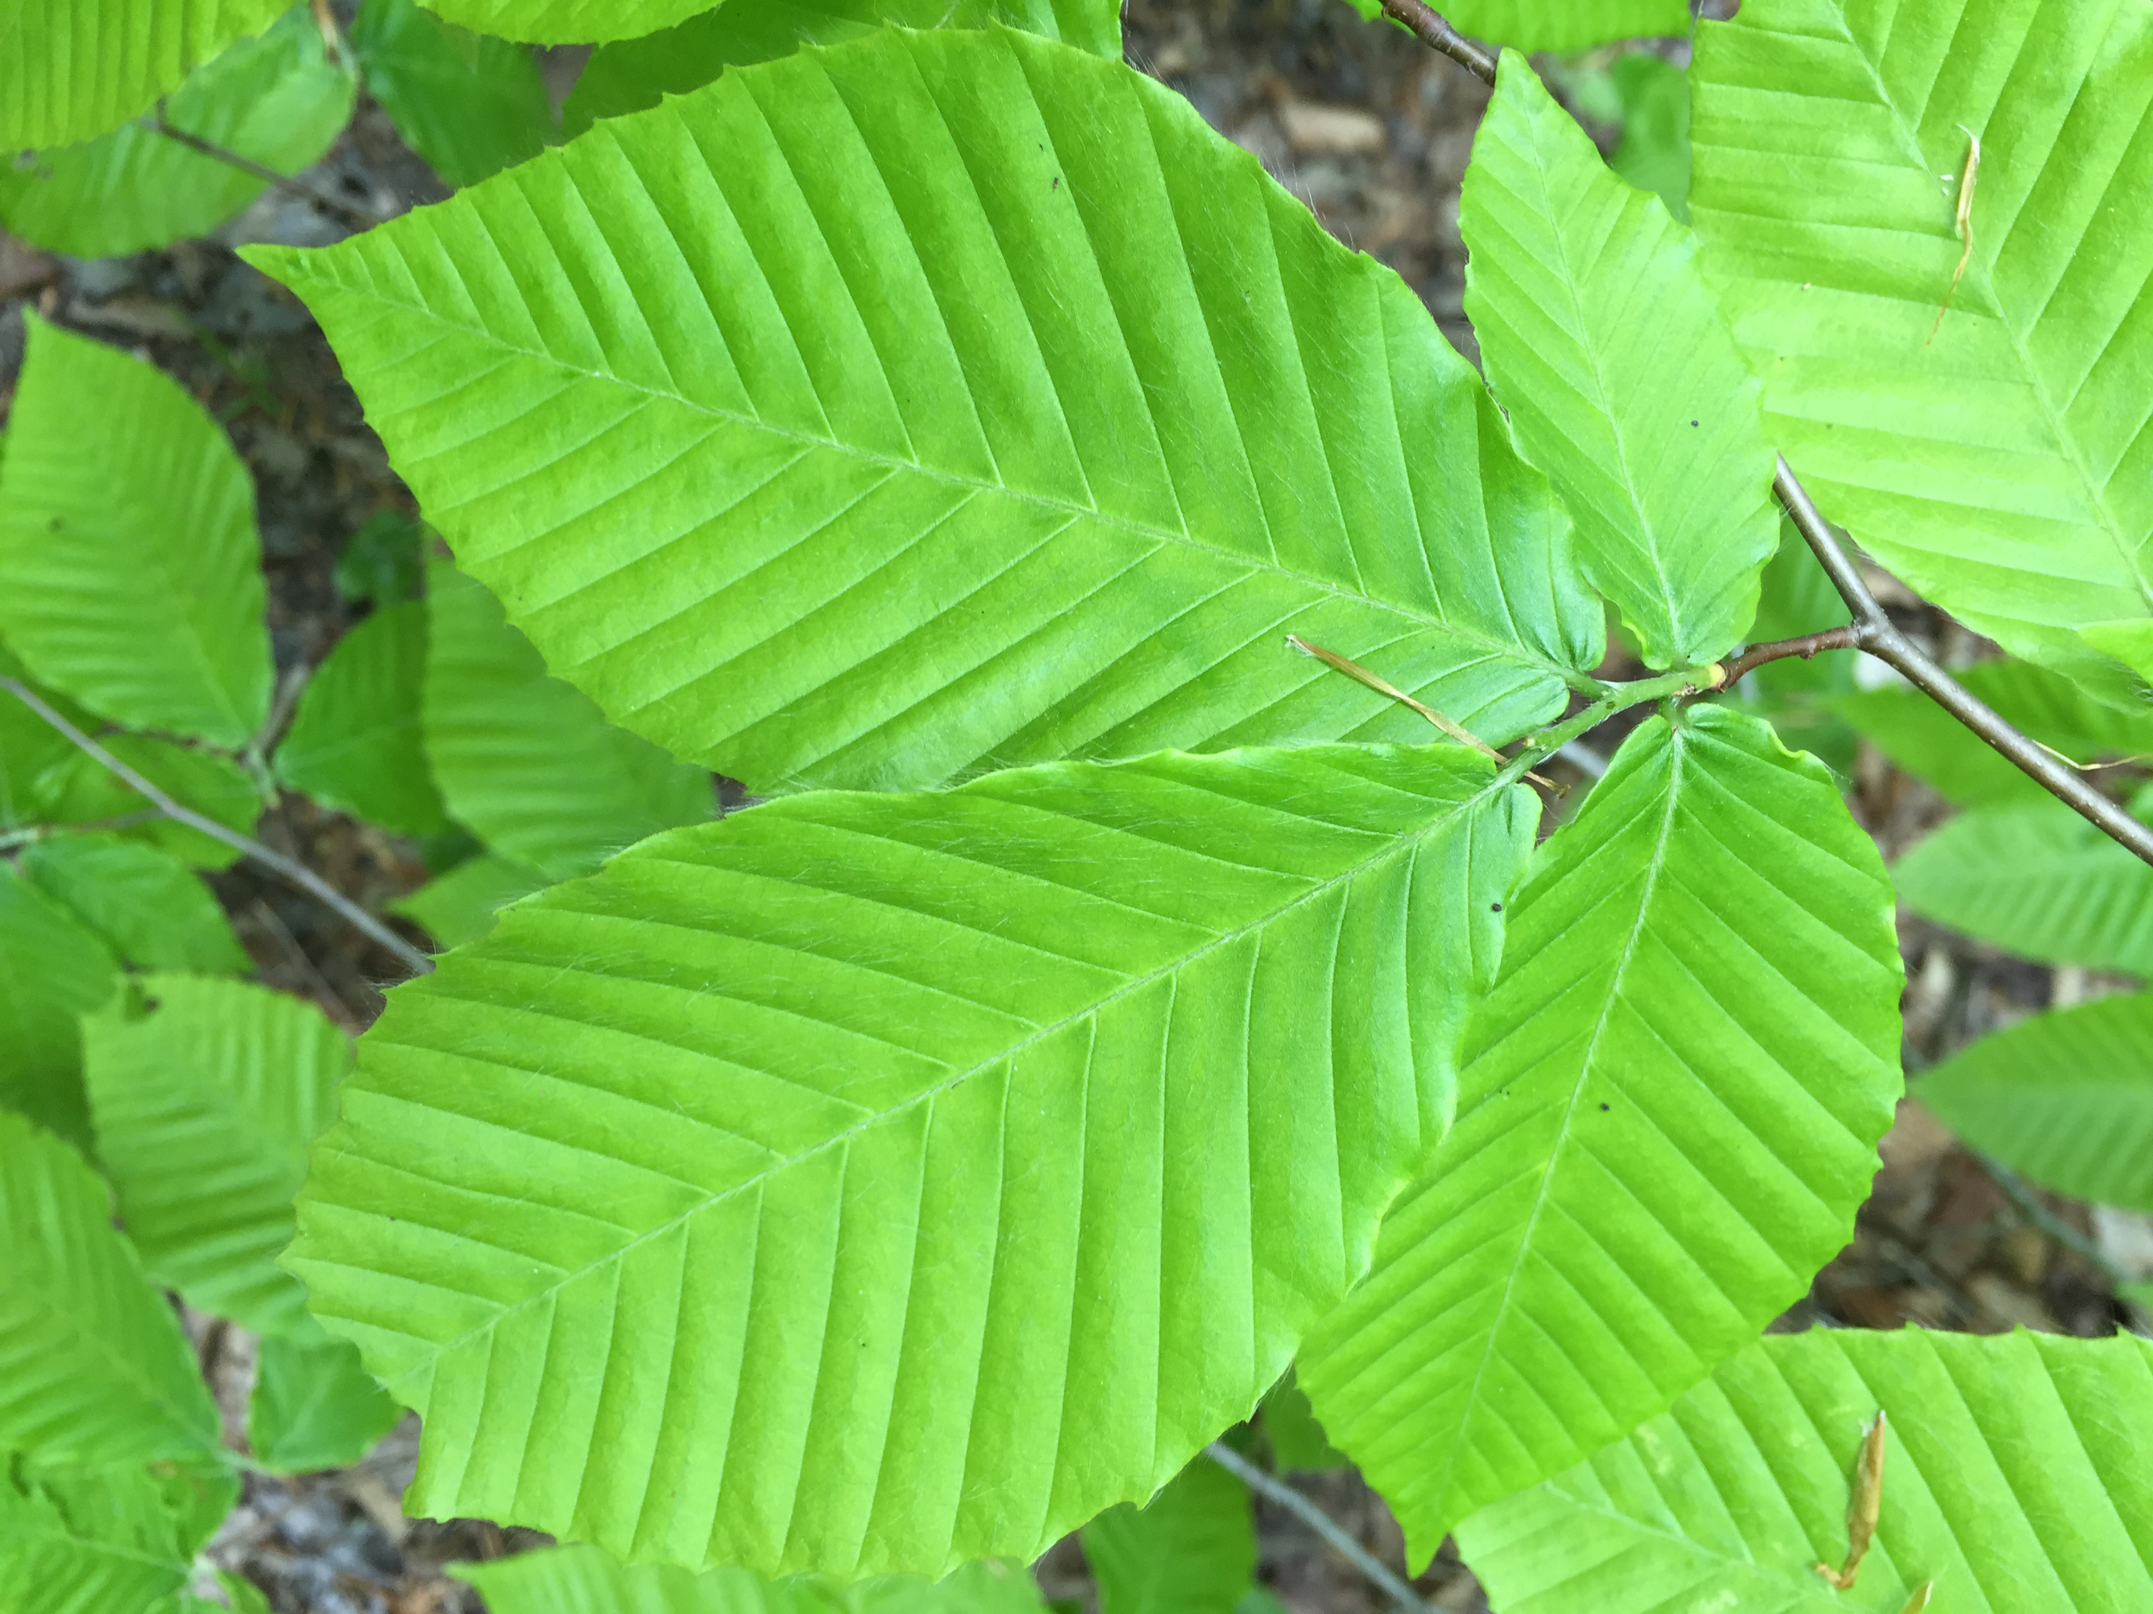
As of Monday, July 12, 2016
Tree Spotters have recorded…
47,798
observations in Nature’s Notebook!

Slide 22
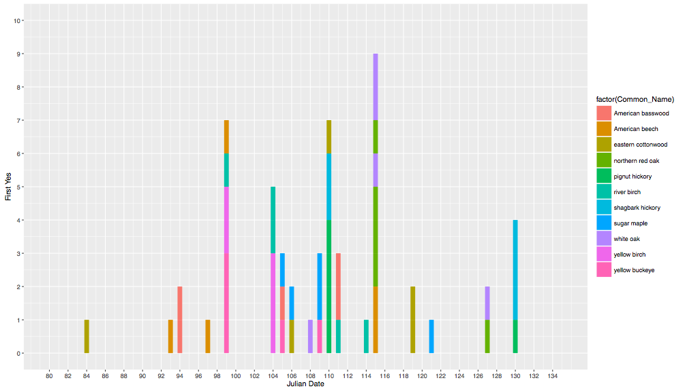
Breaking Leaf Buds:
Date the first “Yes” was recorded for each individual tree
Common Name

Slide 23
Breaking Leaf Buds:
Date the first “Yes” was recorded for each individual tree
The Eastern Cottonwood exhibited the greatest intraspecific variation*
Common Name
*Intraspecific Variation: variation occurring within species, i.e. between individuals of the same species

Slide 24
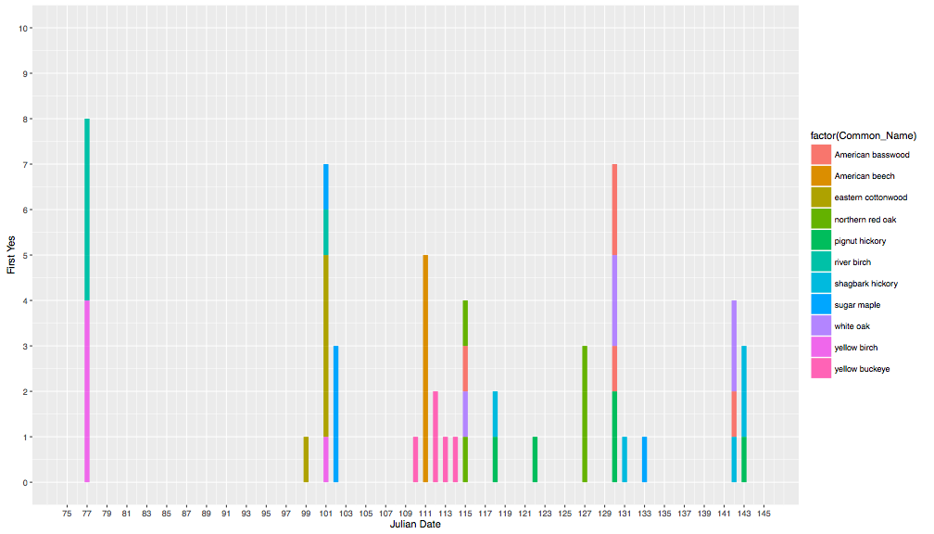
Flowers or flower buds:
Date the first “Yes” was recorded for each individual tree
Common Name
Common Name

Slide 25
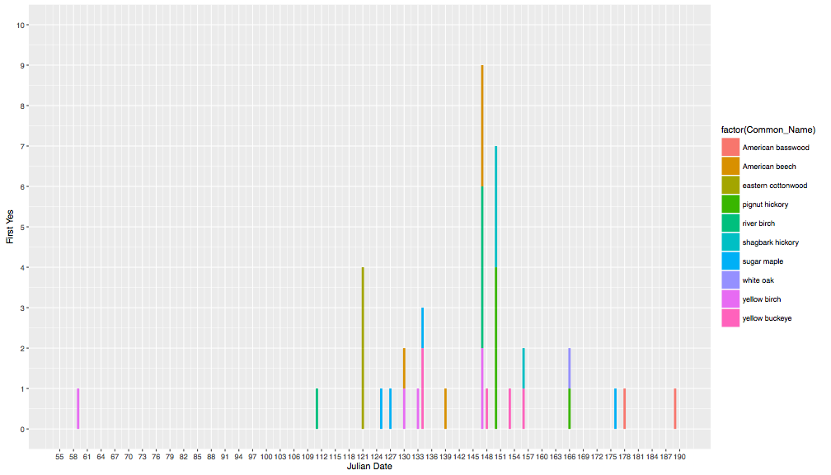
fruits:
Date the first “Yes” was recorded for each individual tree
Common Name

Slide 26
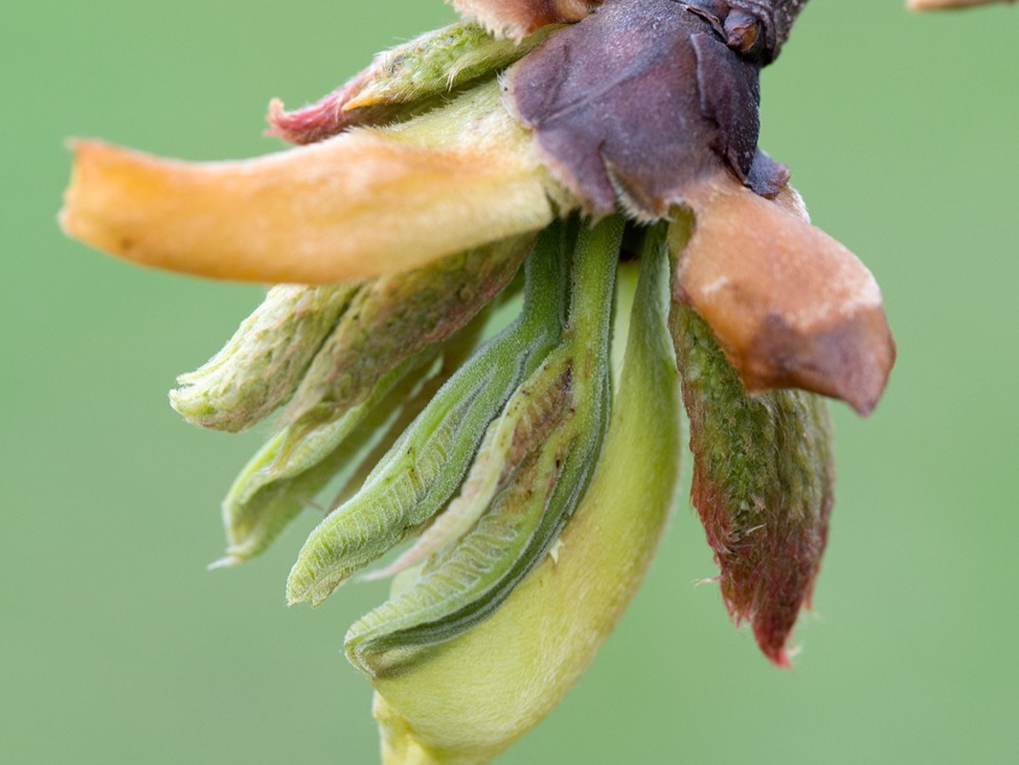
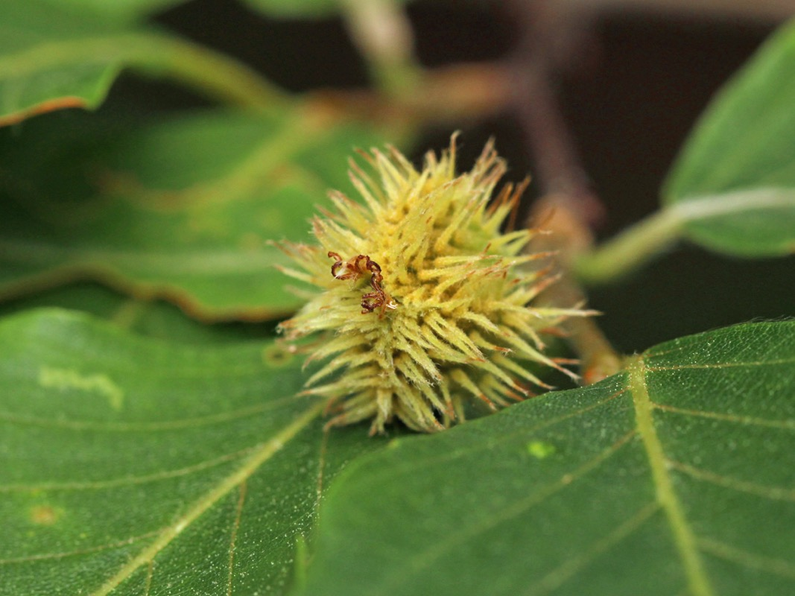
Photographs from our flickr site
Shagbark Hickory
https://www.flickr.com/groups/arnold_arboretum_tree_spotters/
American Beech

Slide 27
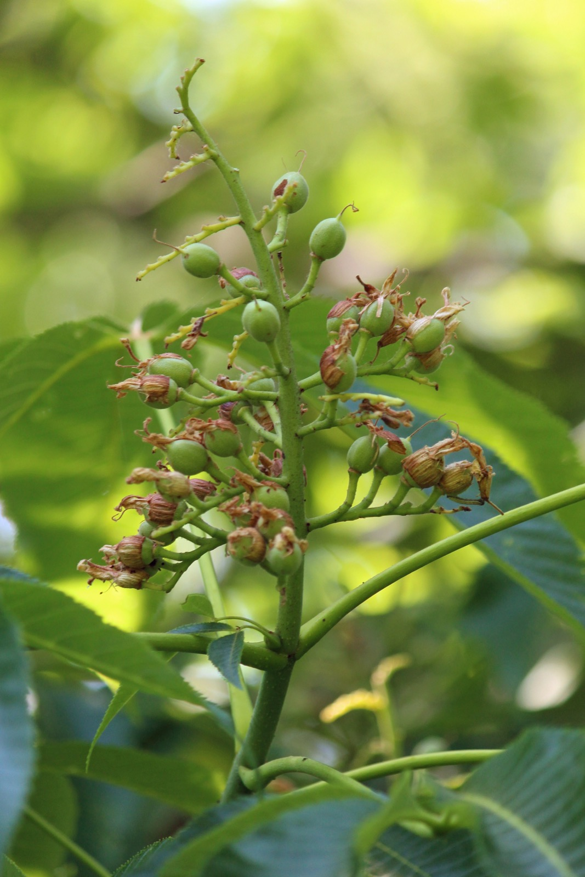
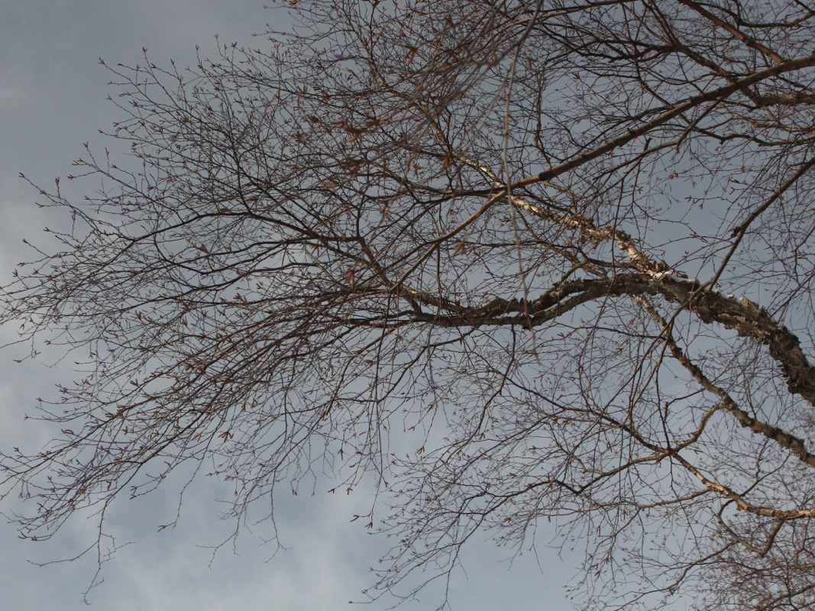
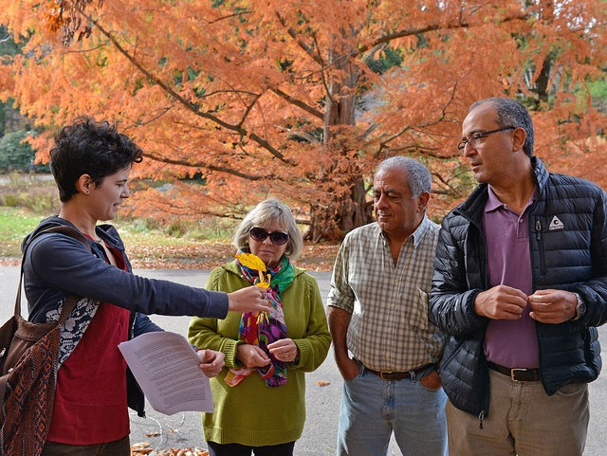
River Birch
Yellow Buckeye

Slide 28
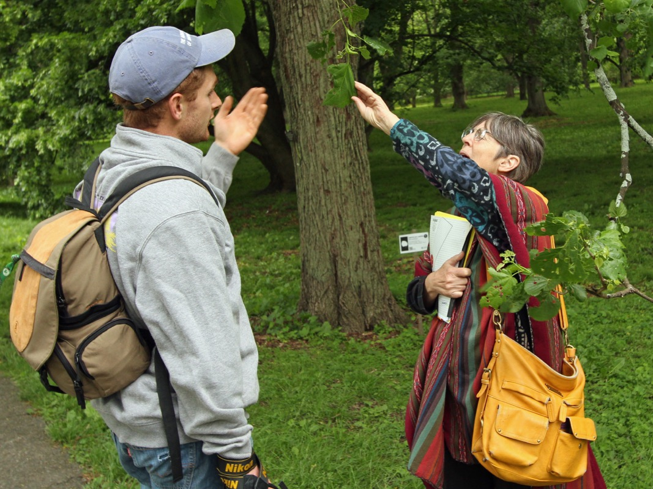
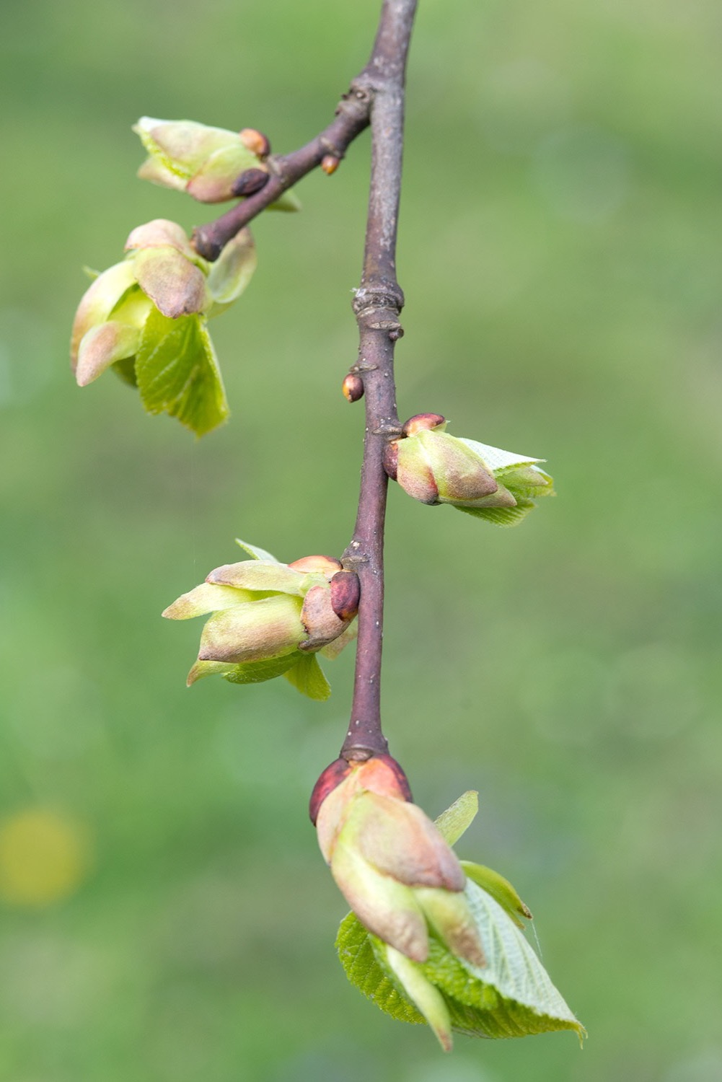
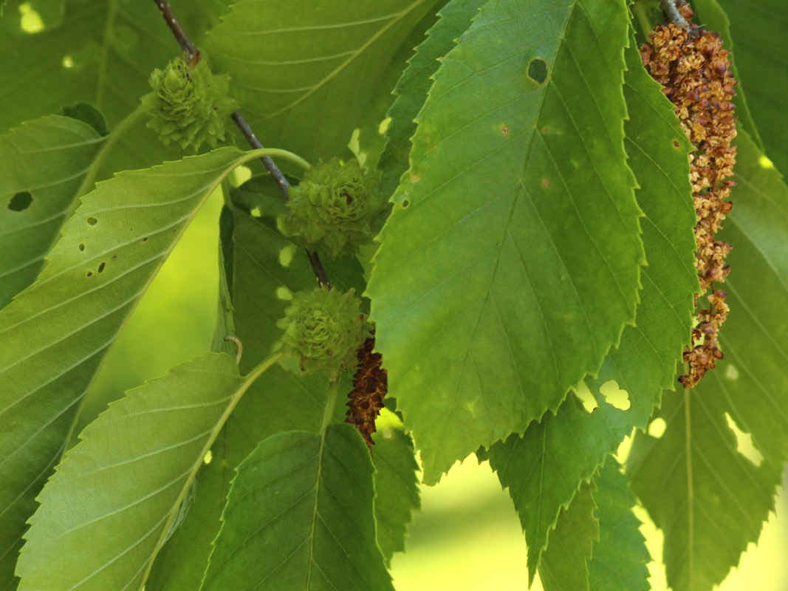
Yellow Birch
American Basswood

Slide 29
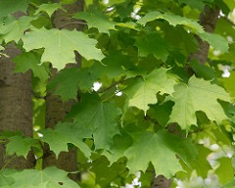
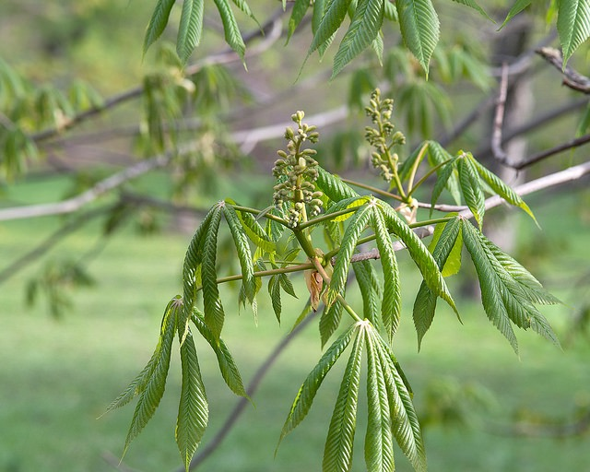

Spotting together:
Written and performed by Brian and katie cartwright
Spotting Together (to the tune of “So Happy Together” by the Turtles, 1967)
Me and you, and you and me.
We’re walking and we see a tree, a big beech tree.
We see a sign and wonder, “Oh, what could that be?”
We’re Spotting Together!
We’ll go up Peters Hill, we will.
We’ll stroll under the big blue sky, like Jack and Jill.
It’s all about phenology; we’ll get our fill.
We’re Spotting Together.
Arnold Arboretum, Tree Spotting we go
All ‘round the grounds.
We see more each time that we get up and go
All ‘round the grounds.
Hickory nuts you’ll find beneath your feet.
They’re good to eat, the meat is sweet – a tasty treat.
A simple pleasure. Oh what fun. They can’t be beat.
We’re Spotting Together!
We’ll see the sugar maple trees and the red oaks
As we’re observing with the fine Tree Spotter folks.
We’ll talk about our trees and maybe crack some jokes
We’re Spotting Together.
Arnold Arboretum, Tree Spotting we go
All ‘round the grounds.
We see more each time that we get up and go
All ‘round the grounds.
We’ll see the linden trees (don’t sneeze).
They say they’re very popular with all the bees.
The buckeyes are a lucky charm, the birches please.
We’re Spotting Together.
We’re Spotting Together.
Enjoying the weather.
Tree Spotting Together. (Ba-ba-ba-ba-ba-ba-ba-ba)
Yes Spotting Together. (Ba-ba-ba-ba-ba-ba-ba-ba)
Spotting Together. (Ba-ba-ba-ba-ba-ba-ba-ba)
We’re Spotting Together. (Ba-ba-ba-ba-ba-ba-ba-ba)
Yes Spotting Together. (Ba-ba-ba-ba-ba-ba-ba-ba)
Tree Spotting Spotting Together. (Ba-ba-ba-ba-ba-ba-ba-ba)

Slide 30
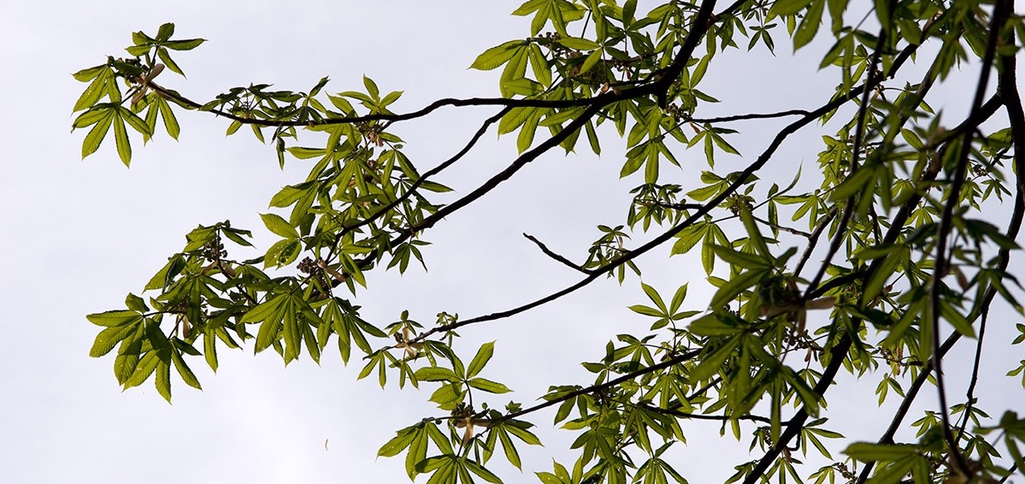
Thank you, Volunteers, for being so dedicated.
There is no way we could do this without you.

